Slide 1
Everything from Scratch A journey as Software Engineer in Test to improve "Testing"
Hiroyuki Ito
(@hageyahhoo)

Slide 2
Question
Have you faced with following troubles
for your test-related activities?
Some members/teams opposed your activities
No one used tools/solutions
you invented/introduced
There were few members who have enough skills/knowledge
Notes:
At first, I have a question.
Please raise your hands.

Slide 3
In My Case as SET
No clear goals by senior managers
etc...
Dissension among developers/testers/managers
Negative feedback to
our tools/solutions
Notes:
BTW, who knows the meaning of “SET”?
“SET” stands for “Software Engineer in Test”, who is responsible for improving processes and developments with automation techniques like Test Automation and DevOps.

Slide 4
We can change difficulties into something special with proper approaches!

Slide 5
Our team invented new ideas/tools/solutions from Scratch!

Slide 6
Goal of This Session
Given we have troubles of testing
When we discuss and share troubles
And I share our solutions
Then we get hints to get over them

Slide 7
Agenda
1. Importance of Getting Supports
2. Experience Hardships Together
3. Nurture All for Innovations

Slide 8
1. Importance of Getting Supports
2. Experience Hardships Together
3. Nurture All for Innovations

Slide 9
Let’s Discuss! (5 min)
What blocks/blocked
Test Automation
in your organization?

Slide 10
My Blockers
Hiro’s
Case
By decision-makers/colleagues:
No clear vision/goals
No shared understanding
No supports
Unclear needs/demands
Notes:
⭐️Discussionの内容を2-3共有してもらう

Slide 11
My Blockers
Hiro’s
Case
By decision-makers/colleagues:
No clear vision/goals
No shared understanding
No supports
Unclear needs/demands
They are critical!
Need to solve!

Slide 12
Points
How to get support/understanding
from
decision-makers
colleagues

Slide 13
Two Useful Techniques
Product Discovery
Giving Impacts

Slide 14
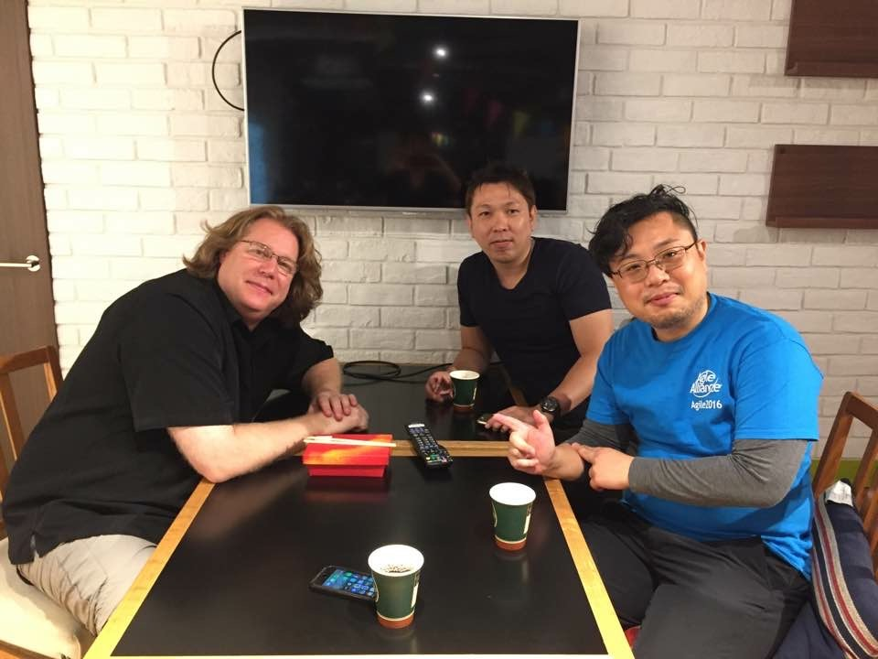
1. Product Discovery
Discovering/refining solutions
by iterative hypothesis and test cycle
By David Hussman
Persona
User Interview
User Story Mapping
MVP
KPI

Slide 15
Discover real concerns of
decision-makers/colleagues
and verbalize them

Slide 16
Verbalized Concerns
Increase of outages in “Channel Gateway” (service) was critical
Need failure detection mechanism for Channel Gateway
Testing APIs was insufficient in each service (Mainly did it manually then)

Slide 17

2. Giving impacts
Making impacts constantly
to attract decision-makers/colleagues

Slide 18



My Example
Hiro’s
Case
Deliver (executable) values weekly

Slide 19
Delivered Values (1)
Week 1 | Started writing test scripts to understand services
Week 2 | Proposed first idea of SET activities to decision-makers
Week 3 | Built mechanism to run and report static code analysis regularly
Week 4 | Shared to developers how to build static code analysis
Week 5 | Proposed milestones of activities to decision-makers

Slide 20
Delivered Values (2)
Week 6 | Agreed with proposals/milestones with decision-makers
Week 7 | Collected information and tools of QA/Tests in one place
Week 8 | Implemented failure detection for Channel Gateway
Week 9 | Guided to start regular meetings with developers and QA persons
Week10 | Started solving problems by developers step by step

Slide 21
Results
Within the first 3 months I joined :D
Many colleagues started talking about SET
Decision-makers started supporting SET activities positively
SET started improvement activities for Channel Gateway service

Slide 22
1. Importance of Getting Supports
2. Experience Hardships Together
3. Nurture All for Innovations

Slide 23
Let’s Discuss! (5 min)
How to persuade
developers
who stopped
writing test scripts?

Slide 24
My Blockers
Hiro’s
Case
By decision-makers/colleagues:
No clear vision/goals
No shared understanding
No supports
Unclear needs/demands
Notes:
⭐️Discussionの内容を2-3共有してもらう

Slide 25
Points
Experiencing hardships with product development teams together is a key to proceed with activities
we could provide innovative ideas and solutions

Slide 26
One Experience Report
Invention&improvemet
of our failure detection system
with Karate framework

Slide 27
Channel Gatewayの課題
本番障害が増加
障害検知が遅れがち
※システムイメージ
Store
User
Channel
Gateway
Game
Others

Slide 28
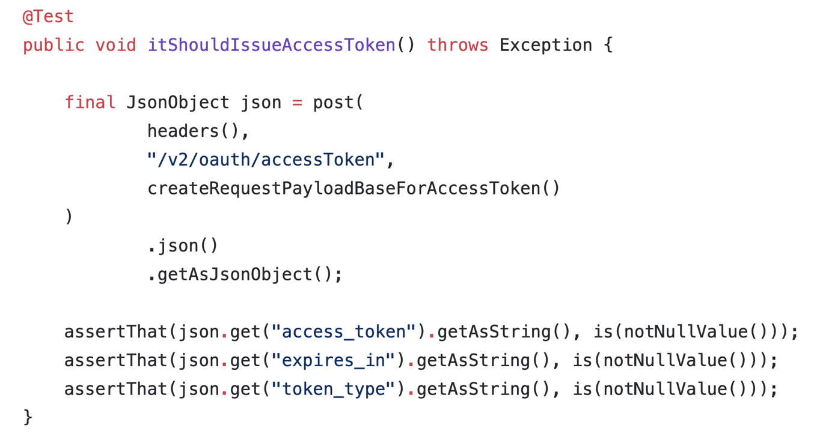
JUnitとCIによる障害検知

Slide 29
JUnitとCIによる障害検知
チームに定着せず
テストコードが読みづらい
テストコードがメンテナンスしづらい
障害を検知した際の対処方法が判断しづらい

Slide 30
What Is Karate?
API Testing framework
OSS
BDD (Gherkin)

Slide 31
解決策としてのKarate
APIテストに特化したOSSフレームワーク
BDDスタイル（Gherkin）
Java製
RESTful APIのテスト機能を標準サポート
gRPCなどは、機能拡張が必要 （ただし容易）
Technology Radarにも掲載
Notes:
[15:00]

Slide 32
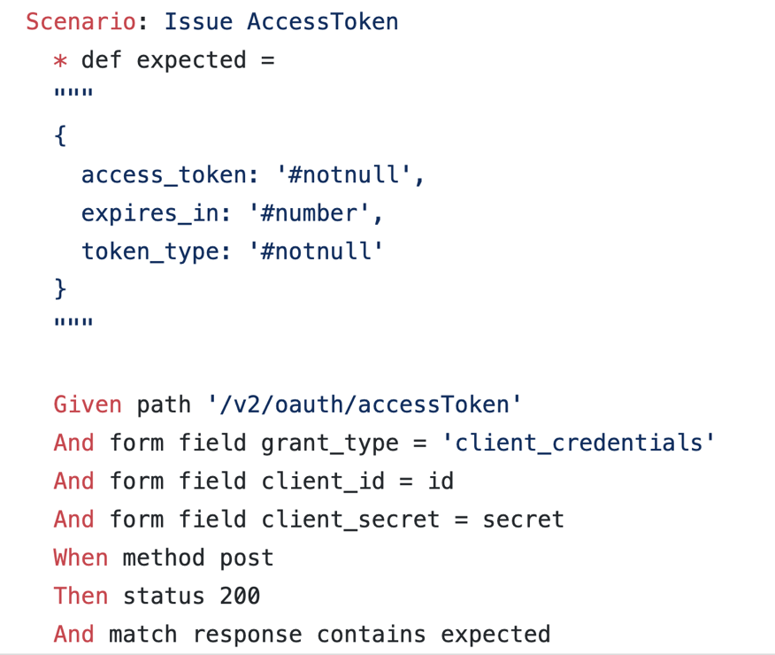
Karateのテストコード例

Slide 33
JUnitのテストコード例

Slide 34
ポイント
チームと3ヶ月一緒に働き、
以下を一緒に繰り返し実施
読みやすい・メンテナンス しやすいツールの選定
不足機能の追加
読みやすいテストコードの 追求
障害検知時の対処方法の整備

Slide 35
Results
Reduced outages Dramatically
Everyone is writing test scripts

Slide 36
成果
存在自体が成功モデルと 言えるチームに！
本番障害：- 30%
障害検知：1週間→ 2時間
自力で課題発見・解決 できるチームに進化
プロダクトマネージャーを 含む全チームメンバーが テストコードを書いている

Slide 37
まとめ
プロダクト開発チームと
共に問題に取り組むことで、
本当に必要なものを
発見・提供できるのでは？

Slide 38
まとめ
プロダクト開発チームと
一緒に痛い目にあうことで、
本当に必要なものを
発見・提供しよう

Slide 39
compassion
[英語] [名詞]
思いやり、共感

Slide 40
compatio
[ラテン語] [名詞]
共に苦しむ

Slide 41
1. Importance of Getting Supports
2. Experience Hardships Together
3. Nurture All for Innovations

Slide 42
Let’s Discuss! (5 min)
What is
the difficulty of
testing Microservices?

Slide 43
Points
Innovative activities require proper skills, knowledge, persons, and so on.

Slide 44
Learning Session
a way to nurture members, teams, and organizations smoothly and quickly.

Slide 45
Sebas Report
Result of Learning Session
to tame the complexity of Microservices
to reduce their outages

Slide 46
Results
Improved MTTR
Users are increasing

Slide 47
Learning Lesson #とは
業務時間中に実施する
勉強会の手法
Chris Lucianさんから 直接教えていただいた手法
RSGT2019 キーノートスピーカー
モブプログラミングの 創始者

Slide 48
SETチームでのルール
基本毎日、30-60分、業務時間中に実施
業務に役立つトピックであれば何でもOK
基本モブプログラミングで実施
批判はしない
楽しむ！

Slide 49
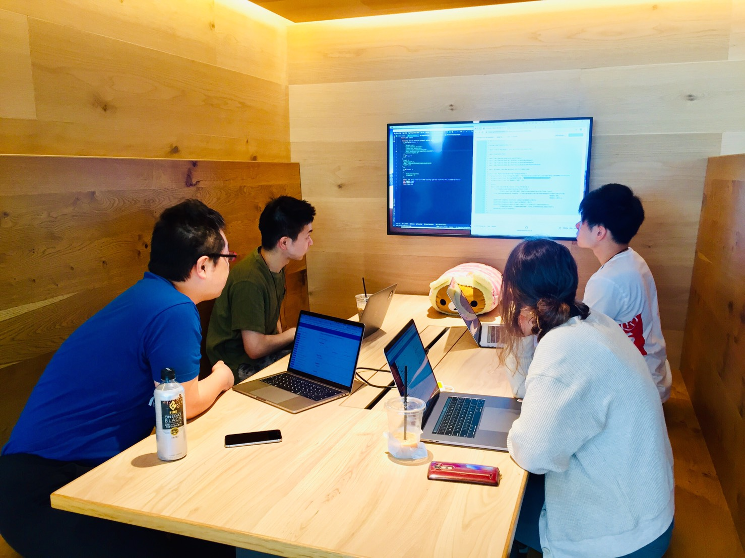
SETチームが学んだこと
Kubernetes
Karate
Vue.js
IntelliJ IDEAの ショートカットキー
ドラッカーエクササイズ
マネージャーをグッと させるレポートの書き方

Slide 50
成果
新メンバーたちが 入社1-2ヶ月で
成果を出せるように
なった！

Slide 51
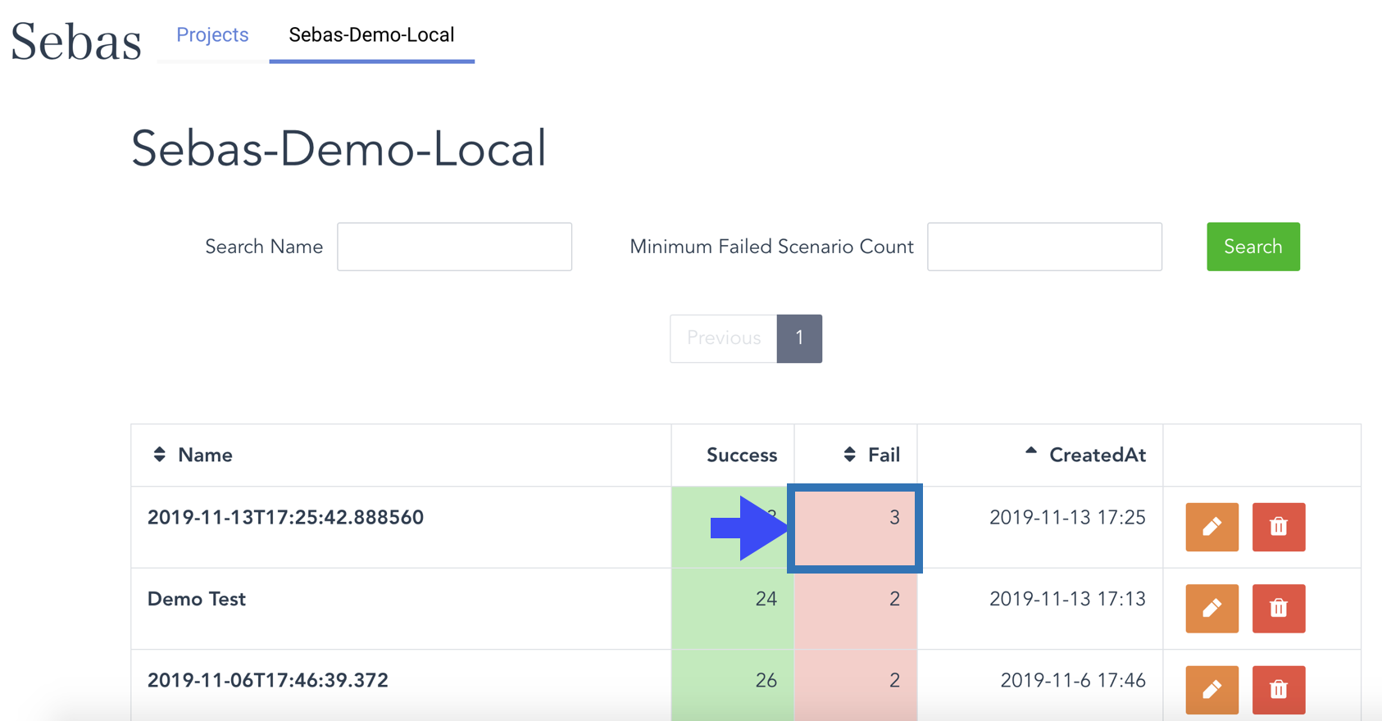
成果例：Sebas Report

Slide 52
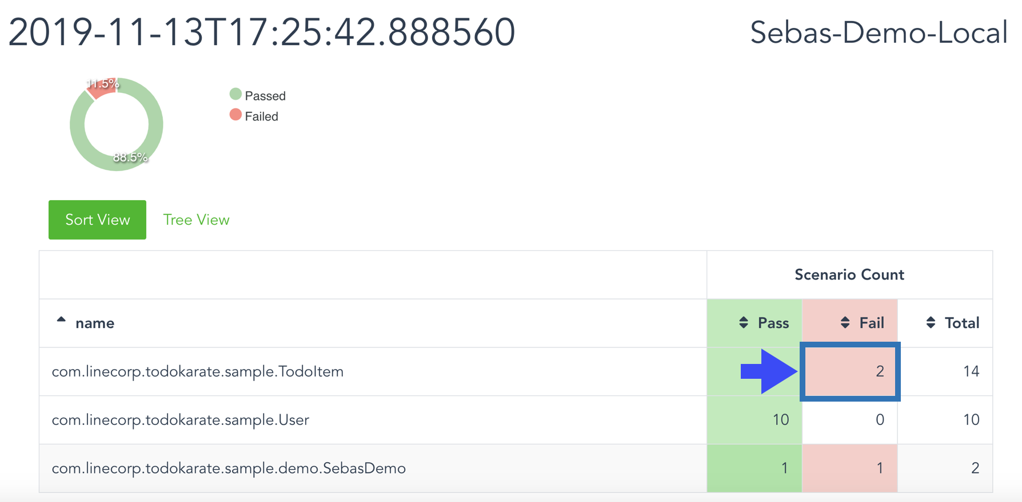
Karateのテストレポートの拡張

Slide 53
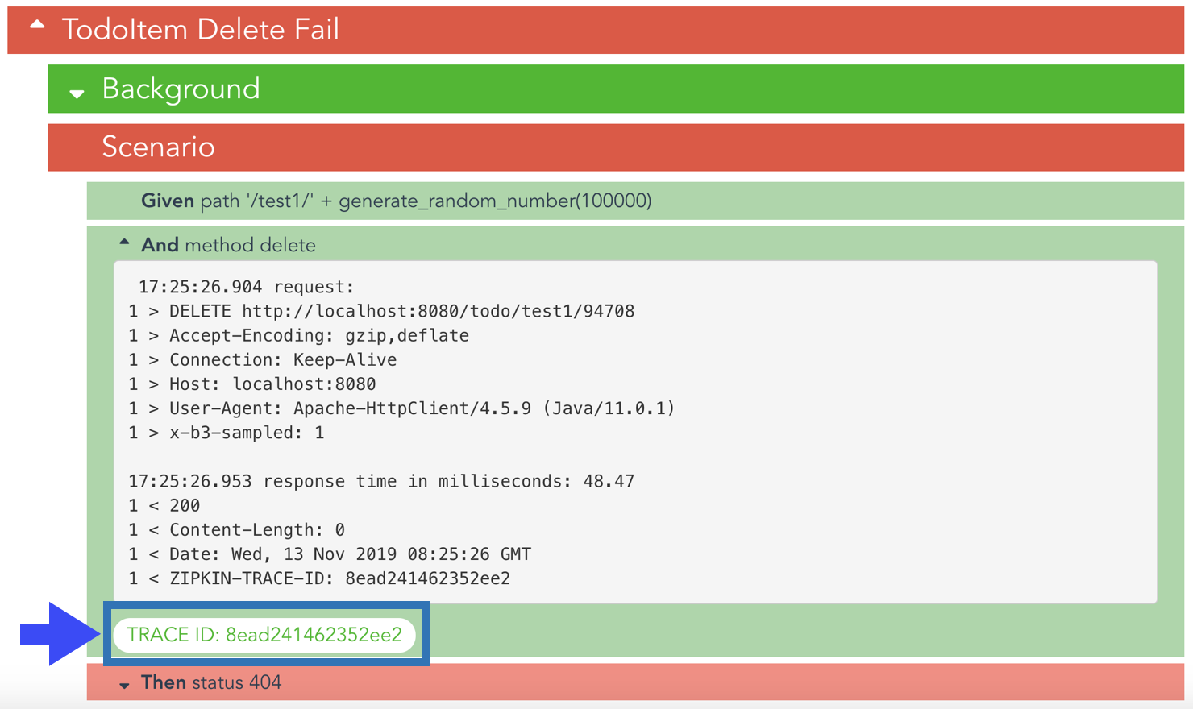
マイクロサービスの障害原因を

Slide 54
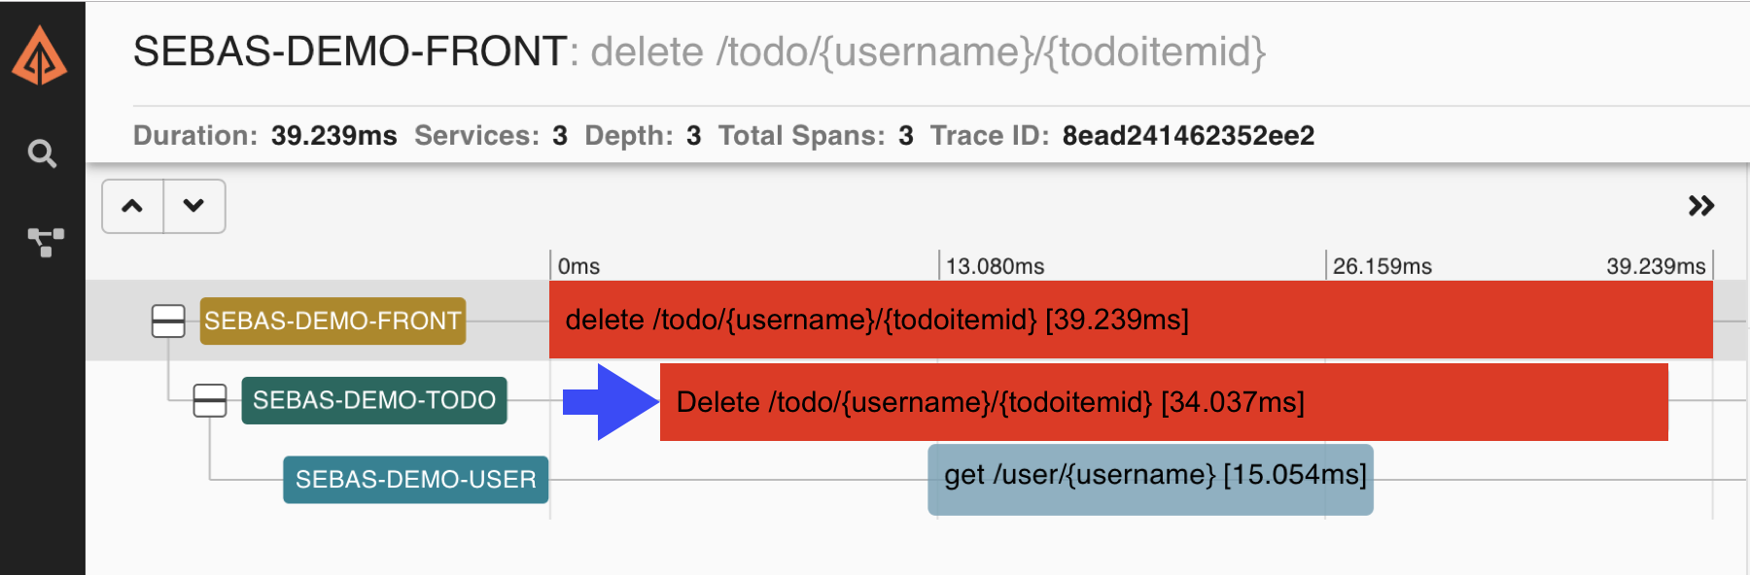
迅速に特定できます

Slide 55

学習したものを活用して…！

Slide 56
Next Actions

Slide 57
Ayaperf
Add later

Slide 58
Design Sprint
Add later

Slide 59
Testable Infrastructure
Add later

Slide 60
Conclusion

Slide 61
Achievements
Some teams convinced themselves with my ideas and started utilizing them.
One team solved its slow test problems on their own.
One team invented a new test infrastructure which made testing easier.

Slide 62
Conclusion
We can change difficulties into something special with proper approaches!

Slide 63
皆さんに 適した 解決策を 皆さんの 手で！

